Slide 1



SESSION NAME HERE
DIFFERENTIATION

Slide 2


Foundational Sessions Housekeeping
The use of disrespectful language is prohibited in the questions, this is a supportive, learning environment for all - please engage accordingly. (FBV: Mutual Respect.)
No question is daft or silly - ask them!
There are Q&A sessions midway and at the end of the session, should you wish to ask any follow-up questions. Moderators are going to be answering questions as the session progresses as well.
If you have any questions outside of this lecture, or that are not answered during this lecture, please do submit these for upcoming Open Classes. You can submit these questions here:
SE Open Class Questions or DS Open Class Questions

Slide 3
Foundational Sessions Housekeeping cont.
For all non-academic questions, please submit a query: www.hyperiondev.com/support
Report a safeguarding incident: www.hyperiondev.com/safeguardreporting
We would love your feedback on lectures: Feedback on Lectures

Slide 4


Reminders!
GLH requirements and lecture materials
Guided Learning Hours By now, ideally you should have 7 GLHs per week accrued. Remember to attend any and all sessions for support, and to ensure you reach 112 GLHs by the close of your Skills Bootcamp.
Lecture Materials Lecture materials can be found in the DS repository for Data Science students and SE repository for Software Engineering students.
CONFIDENTIAL

Slide 5
Progression Criteria
✅ Criterion 1: Initial Requirements
Complete 15 hours of Guided Learning Hours and the first four tasks within two weeks.
✅ Criterion 2: Mid-Course Progress
Software Engineering: Finish 14 tasks by week 8.
Data Science: Finish 13 tasks by week 8.
✅ Criterion 3: Post-Course Progress
Complete all mandatory tasks by 24th March 2024.
Record an Invitation to Interview within 4 weeks of course completion, or by 30th March 2024.
Achieve 112 GLH by 24th March 2024.
✅ Criterion 4: Employability
Record a Final Job Outcome within 12 weeks of graduation, or by 23rd September 2024.
CONFIDENTIAL

Slide 6


What is a gradient of a linear function?
A number which represents the direction of a line
A gradual change in steepness of a line
A constant value which represents the rate of change of the function
A point where the function intercepts the y-axis

Slide 7
How can you calculate the gradient of a linear function?
m = (y + c) / x
m = (ymax - ymin) / (xmax - xmin)
m = (x2 - x1) / (y2 - y1)
m = ∆y / ∆x

Slide 8
What is the derivative of a function?
The rate of change of the function’s output with respect to the input variable of the function
Another function which looks and behaves similar to the function
The average rate of change of the function over the entire domain
The gradient of a multivariate function

Slide 9

Recap of Permutations and Combinations

Slide 10

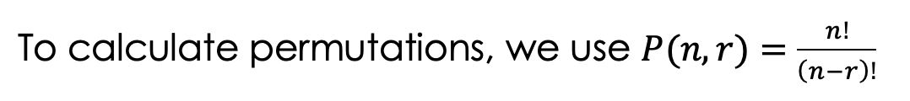
Permutations
Arrangement of objects where order is important.
Where:
n is the number of objects available to choose from
r is the number of objects that are chosen
! is the factorial.

Slide 11
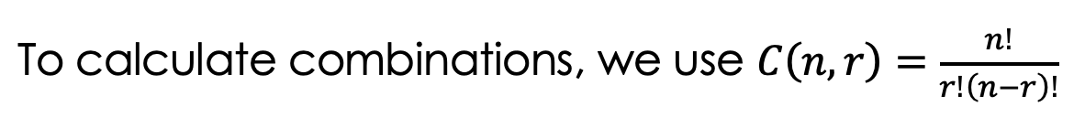
Combinations
Selection where order doesn’t matter.
Where:
n is the number of objects available to choose from
r is the number of objects that are chosen
! is the factorial

Slide 12

Differentiation Topics
Gradients in Linear Functions
Gradients and Derivatives
Rules of Differentiation

Slide 13
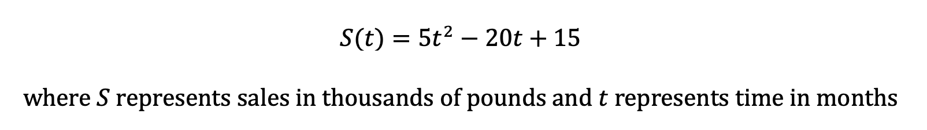
How do sales change with respect to time?
Consider a entertainment company that sells video games. They determine that their sales over time can be represented with the following function:
What can we do to understand more about how sales are changing over time?
How can we identify periods of growth, decline and stability?

Slide 14

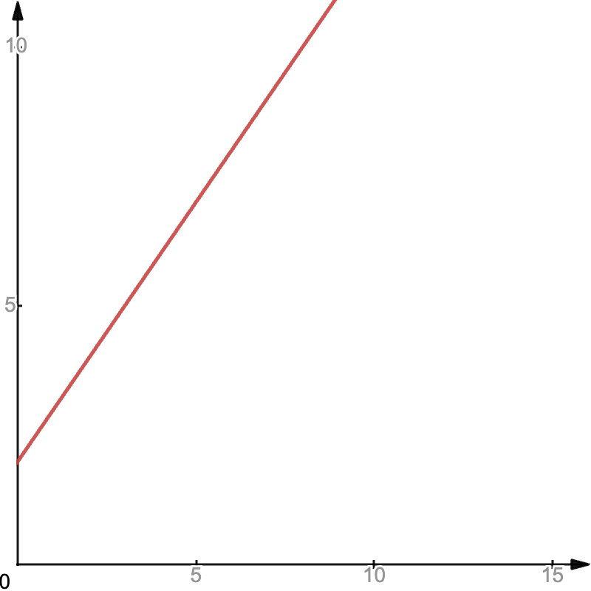
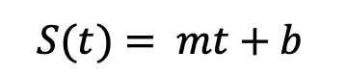
Example: Linear Sales Function
b is the initial sales (y-intercept)
m is the rate at which the amount of sales changes with respect to time
The graph shows a function where m = 1
Since the gradient is positive, sales increase with time

Slide 15
Gradients in Linear Functions
The gradient or slope is a constant value that represents the rate of change of the function.
The gradient of a linear function tells us how the function changes with respect to the input variable (usually x).
A positive gradient means the function increases and a negative gradient means the function decreases.
As the magnitude of the gradient increases, so does the steepness of the slope of the line.
If the gradient is 0, the function is a horizontal line.

Slide 16
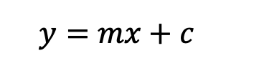
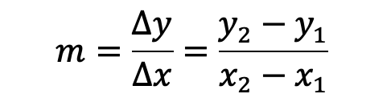
Gradients in Linear Functions
In the equation of a linear graph:
m is the gradient of the function
The gradient is calculated as the change in y over the change in x or “rise over run”:
using two points on the line (x₁ , y₁) and (x₂ , y₂)

Slide 17
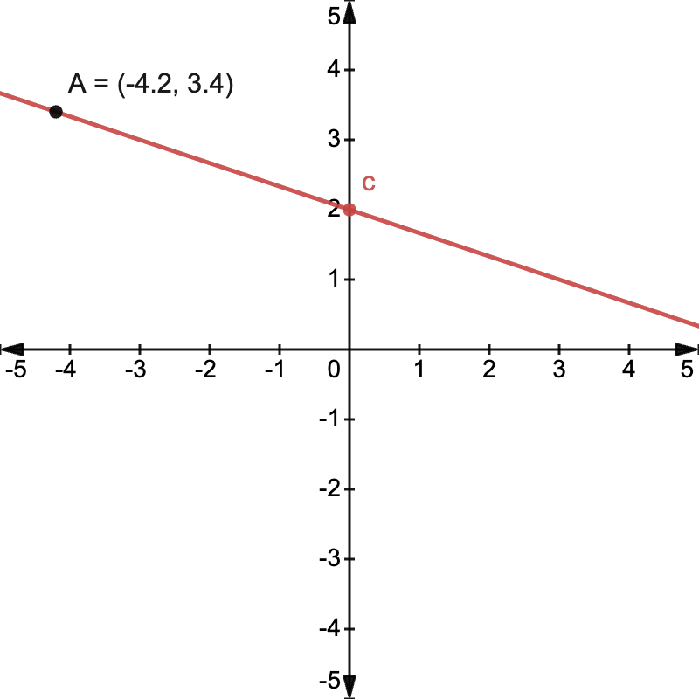
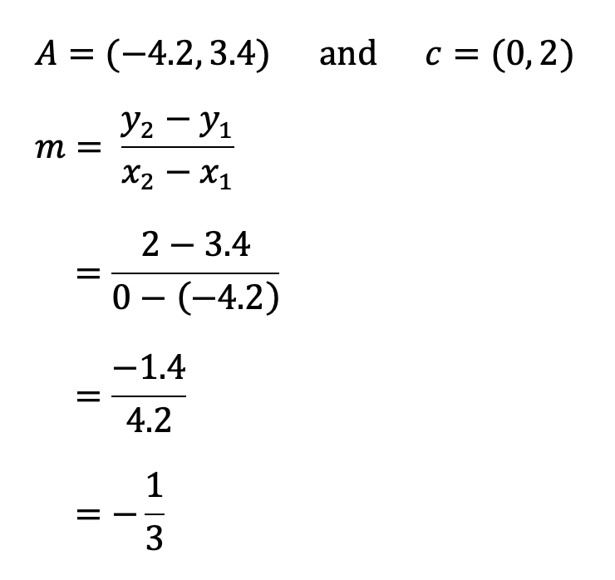
Example: Gradients
Given the following graph, calculate the gradient of the function.

Slide 18
Derivatives
The derivative of a function represents the rate of change of the function with respect to an independent/input variable.
Linear functions have a constant rate of change/gradient, other types of functions do not e.g. quadratic functions
The derivative of a function is another function which describes the instantaneous rate of change of the function at any point.
The derivative of a linear function is the gradient, since the rate of change at any point will be the same, thus a constant.
Not all functions have a derivative. Functions that have a derivative are called differentiable functions.

Slide 19
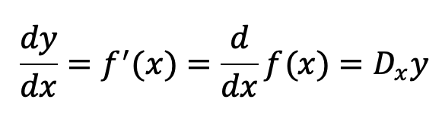
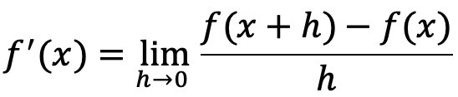
Rules of Differentiation
Notation: For the function f(x) = y, the derivative of f with respect to x is denoted by:
Limits: The derivative is calculated using limits:
This process is long and complicated, instead we use rules that have been derived from this formula.

Slide 20
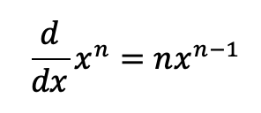
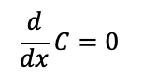
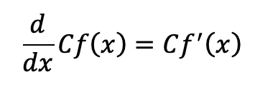
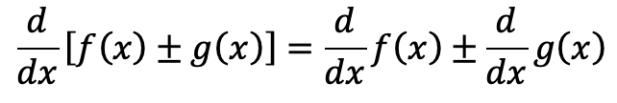
Rules of Differentiation
Constant rule: if C is a constant,
Constant multiple rule: if C is a constant,
Power rule
Sum and Difference rule

Slide 21
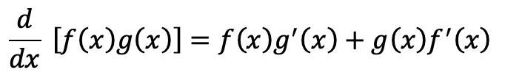
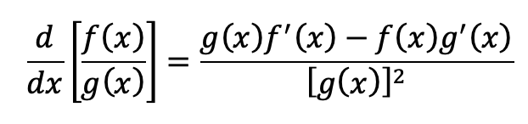
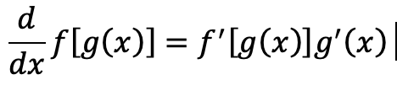
Rules of Differentiation
Product Rule
Quotient Rule (derived from product rule)
Chain Rule

Slide 22
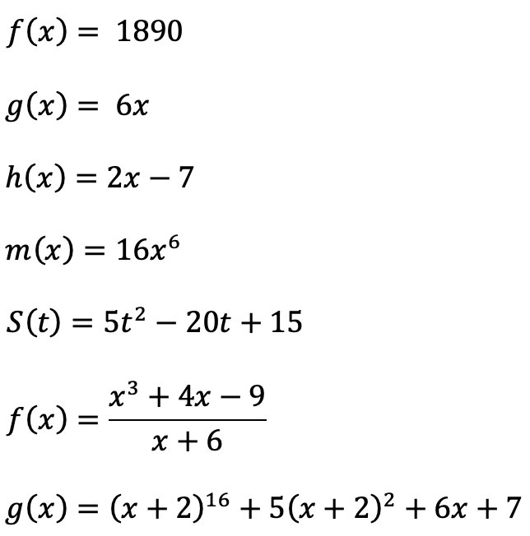
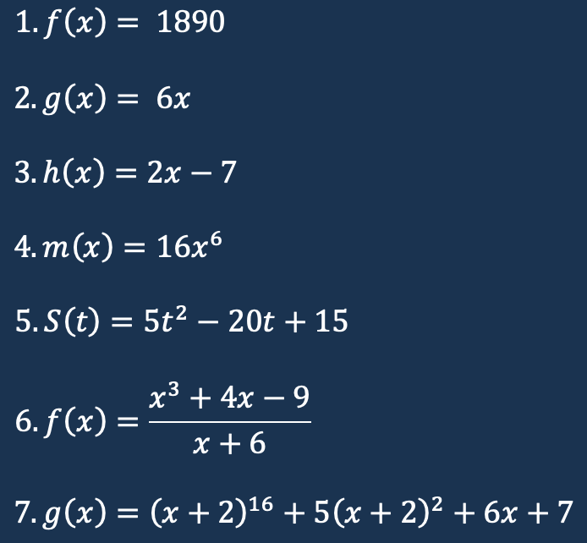
Worked Example
Calculate the derivative of the following functions:

Slide 23
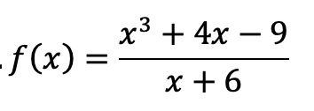
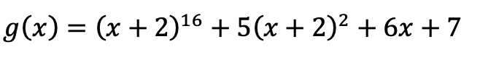
Worked Example
5.
6.
7.
Calculate the derivative of the following functions:

Slide 24
Worked Example
….
f’(x) = 0
g’(x) = 6
h’(x) = 2
… m’(x) = 6 x 16x⁵ = 96x⁵
Calculate the derivative of the following functions:

Slide 25
Worked Example
5.
S’(t) = 10t - 20
6.
f’(x) = [(3x² + 4) * (x+6) - (x³ + 4x - 9) * 1]/(x + 6)²
7.
g’(x) = 16(x+2)¹⁵ * 1 + 10(x+2) * 1 + 6
Calculate the derivative of the following functions:

Slide 26
Summary
Gradients of Linear Functions
A constant value representing the rate of change of the function.
Calculated by dividing the change in y by the change in x.
Derivatives
A function representing the instantaneous rate of change of a function at any point.
The gradient of a linear function is equal to the derivative of the function.
Rules of Differentiation
There are 7 rules of differentiation that we use to determine the derivative.

Slide 27
Further Learning
Math Centre - Linear Functions
Khan Academy - Linear equations, functions, & graphs
LibreTexts - Directional Derivatives and the Gradient
OpenStax - Calculus 1

Slide 28
Which of the following is a correct differentiation rule?
f’(x) = m
f’(mx) = m f’(x)
f’(a + b) = f’(a) + f’(b)
f’(x - a) = -a

Slide 29
What can be said about a linear function with a gradient of -9?
The line is curved and increasing.
The line is straight and steep, and is decreasing.
The line is decreasing, with a gentle slope.
The line is straight and decreasing, with a gentle slope.

Slide 30
Questions and Answers
Questions around Sets, Functions and Variables

